Slide 1
Image Classification Keras and Transfer Learning
Name

Slide 2
CIFAR-10:
CIFAR-10: Essential dataset with 60,000 32x32 color images in 10 diverse classes.
Challenges: Small image size challenges model details; diverse classes test generalization.
Usage: Benchmarking models, educational tool for teaching ML concepts.
Common Tasks: Image classification, object recognition, and model evaluation.

Slide 3
Transfer Learning (1/2)
Using pre-trained models like VGG19, which have already been refined on enormous datasets, is how transfer learning in Keras for image classification works. When compared to training from scratch, these models serve as feature extractors, saving you both time and data.
Transfer learning allows you to fine-tune the pre-trained model with only your particular classes in situations where your own dataset is limited. When compared to training a simple model from scratch on sparse data, this greatly improves performance.

Slide 4
Transfer Learning (2/2)
Important low-level properties like edges and textures have been taught to pre-trained models. For your particular goal, you simply need to train new top layers, which speeds up the process and might result in improved generalization.
Even for novices, transfer learning is made possible using Keras. You don't need a lot of processing power or specialized knowledge to create strong image classifiers when you have access to widely available pre-trained models and simple code.

Slide 5
VGG19
The 19-layer VGG19 deep convolutional neural network architecture is renowned for its consistency and ease of use.
VGG19, which was pre-trained on the ImageNet dataset, can extract rich features from a wide variety of images.
Created in 2014 as part of the ImageNet Large Scale Visual Recognition Challenge (ILSVRC).
Aimed to demonstrate its effectiveness in large-scale image recognition problems by classifying items into 1,000 distinct different categories.
VGG19 has a simple architecture made up of three fully connected layers and sixteen convolutional layers.
In image classification, VGG19 performed competitively despite its simplicity, which is why it is a popular candidate for transferred learning.

Slide 6
Fine-Tuning Steps
Selective Unfreezing: 10 layers of the 22-layer VGG19 base model were unfrozen, enabling controlled modification while maintaining previously learned information.
Batch Size and Epochs: used 20 epochs, which affected model convergence and generalization, and a batch size of 64 for effective training iterations.
Iterative Training: used an iterative fine-tuning approach, making several cycles of systematic adjustments to the frozen and unfrozen layers.
Adaptation to Specific Task: The model experienced a process of adaptation by selective unfreezing, adjusting its expertise to the specifics of the target image categorization task.

Slide 7
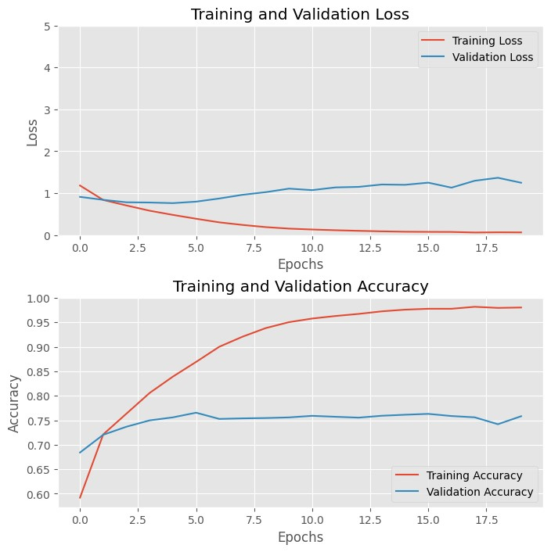
Model Performance (Train – Val)

Slide 8
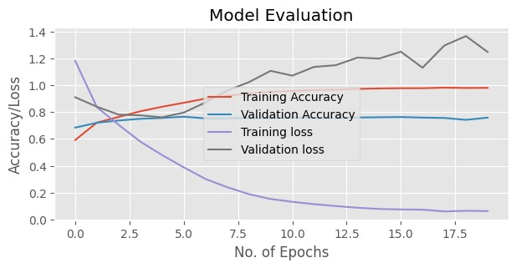
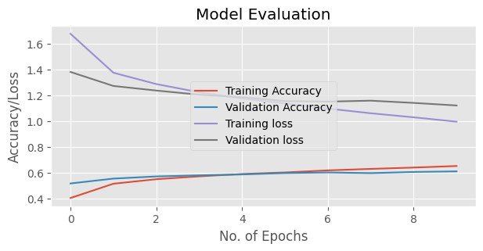
Transfer Learning vs Scratch Model

Slide 9
Limitation and Improvements
Domain Differences: Performance may be hampered by pre-trained models' poor generalization to tasks with wildly disparate visual features or distributions.
Model Size and Complexity: Large pre-trained models can be difficult to deploy and fine-tune computationally, which restricts their use on devices with limited resources.
Domain Adaptation: Performance can be improved by bridging domain gaps and utilizing strategies like adding domain knowledge, employing pre-trained models suited to a certain domain, or fine-tuning additional layers.
Model Efficiency: Reducing model size and computational cost for edge device or real-time application deployment is possible with EfficientNetV2, MobileNet, and pruning/quantization techniques.

Slide 10
Conclusion
To sum up, the VGG19 model's layers were deliberately unfrozen during the fine-tuning phase, which employed a batch size of 64 and 20 training epochs.
The iterative process sought to identify the best arrangement for striking a balance between adapting to the particular image classification task and using pre-trained features.
The model performs better in the fine tuning as compared to the model from the scratch.

Slide 11
References
Li, Y., Zhang, J., Sun, Y., Guo, X., & Wu, Y. (2023). A Light and Deep Network for Image Classification with Data Augmentation. arXiv preprint arXiv:2301.03108.
Xu, Z., Huang, Y., Li, X., Xie, J., & Liu, H. (2023). Hybrid Attention Model with Adaptive Depth for Image Classification. arXiv preprint arXiv:2301.08053.
Gu, X., Zhang, Y., Yang, H., Ma, J., & Jiang, B. (2023). Progressive Feature Encoding for Large-Scale Image Classification. arXiv preprint arXiv:2301.08456.

